Slide 1
Communication and Ethics for International Medical Graduates in Australia
Teaching resources to accompany IMG interview videos
R Woodward-Kron, E Flynn, C Delany
The University of Melbourne for Postgraduate Medical Council Victoria

Slide 2
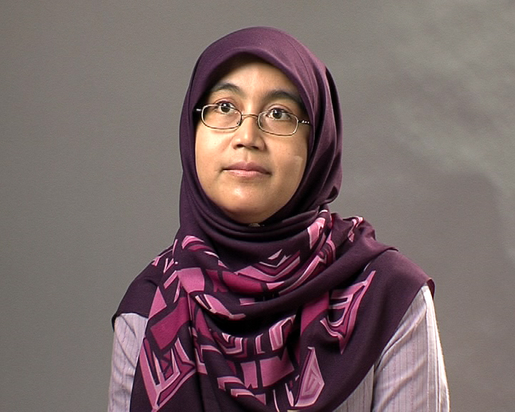
IMG perspectives on differences
Watch the differences video
Differences the doctors noted included:
  • Organisation of training
  • Hospital hierarchy
  • Hospital communication systems
  • Availability of human resources
  • Patient knowledge and awareness of their medical conditions
  • Rosters
  • Allied health availability
  • Social support for patients

Slide 3
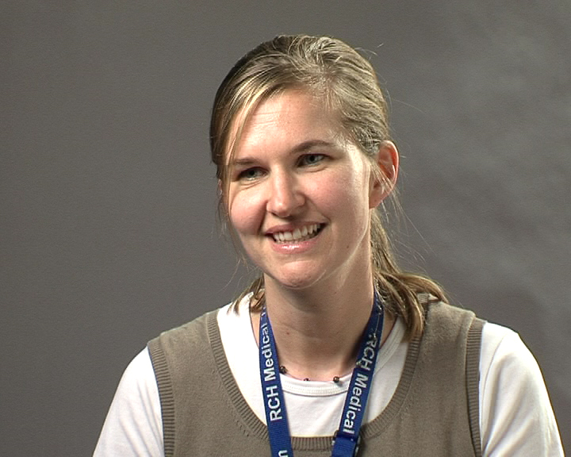
IMG perspectives on differences
For discussion:
• What differences do you notice between Australian hospitals and where you did your training?
• Which things about Australian hospitals were the most different for you?
• Do you think ‘efficiency’ is an ethical issue?
How have you managed the differences between
• Australian hospitals and the ones in your home country, or where you last worked?

Slide 4
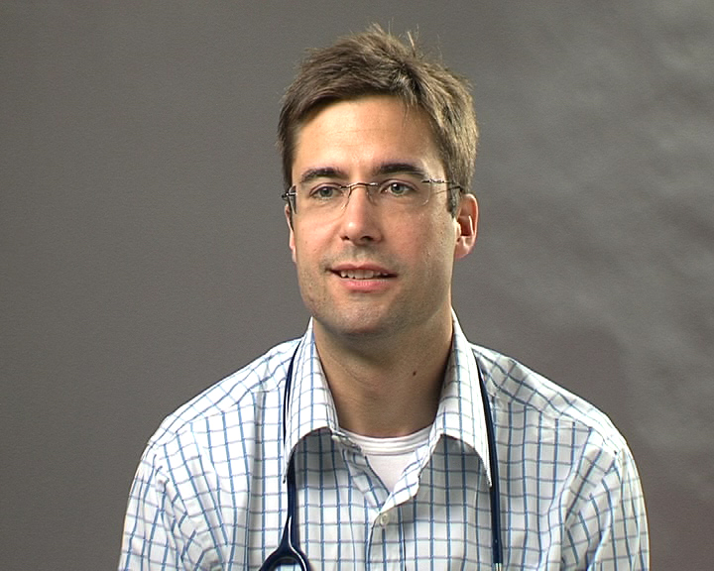
IMG perspectives on ethics
Watch the ethics video
Ethical issues that the doctors noted:
  • Differences in prescribing contraceptives to young women
  • Greater emphasis on patients’ rights in Australia
  • Mandatory reporting of suspected child abuse
  • Less emphasis on the value of life

Slide 5
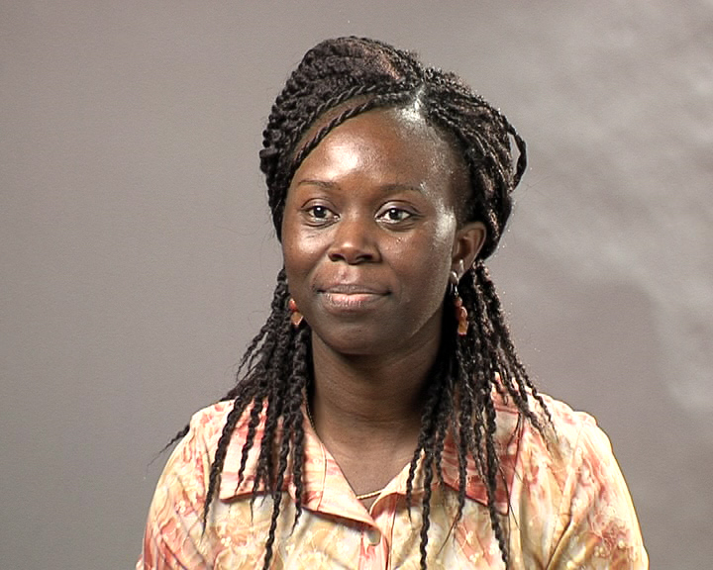
IMG perspectives on ethics
For discussion:
• Do you think religion has any connection with ethics and clinical practice?
• Can you give some examples of how the law impacts on clinical practice in Australia?
• What factors influence doctors’ decisions?
• What are the ethically important things in the relationship between doctor & patient?
• Are there differences in how doctors make end of life decisions in different countries?

Slide 6
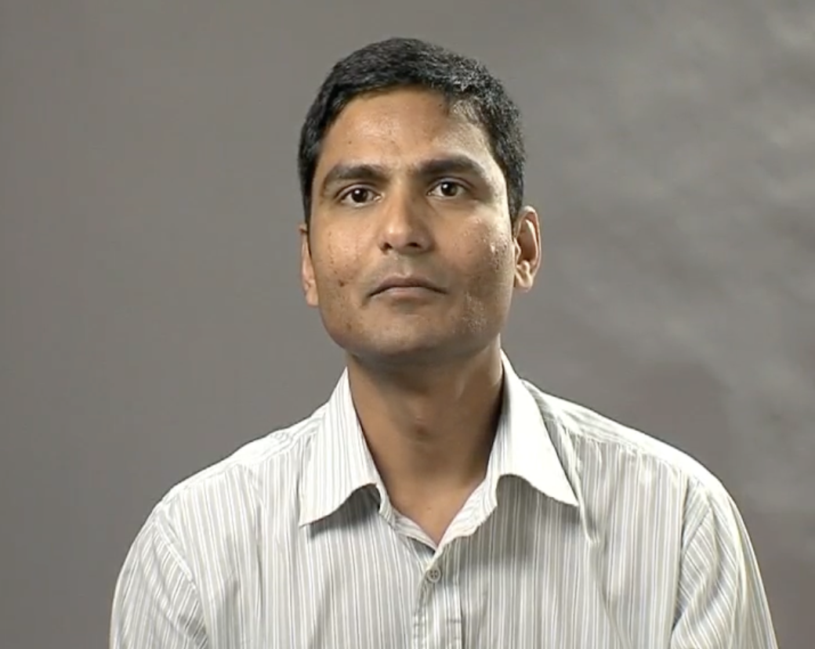
IMG perspectives on communication
Watch the communication video
Communication issues that the doctors noted:
• Australian slang and abbreviations, medical and non medical
• Patients’ accents & non English speaking patients
• Patients not understanding the doctor
• Patients understanding more about their disease & treatment than patients in your
home country
• The need to change how the doctor speaks

Slide 7
IMG perspectives on communication
For discussion:
• Which Australian words or phrases did you have most difficulty understanding?
• Have there been times when you had to change the way you spoke so that patients or other staff could understand you?
• Do you think patients and doctors have a more equal relationship than they do in your home country, and does this make a difference to communication between doctors and patients?
• What communication issues have been the most challenging for you?
• Do you have trouble understanding particular groups of patients, e.g., older people, children etc.

Slide 8
IMG perspectives on communication
For discussion:
• Biola from Nigeria describes the doctor - patient relationship in Australia as a ‘mutual relationship’
• Why do you think she describes the relationship in this way?
• Would you describe the doctor patient relationship in your country in this way?

Slide 9
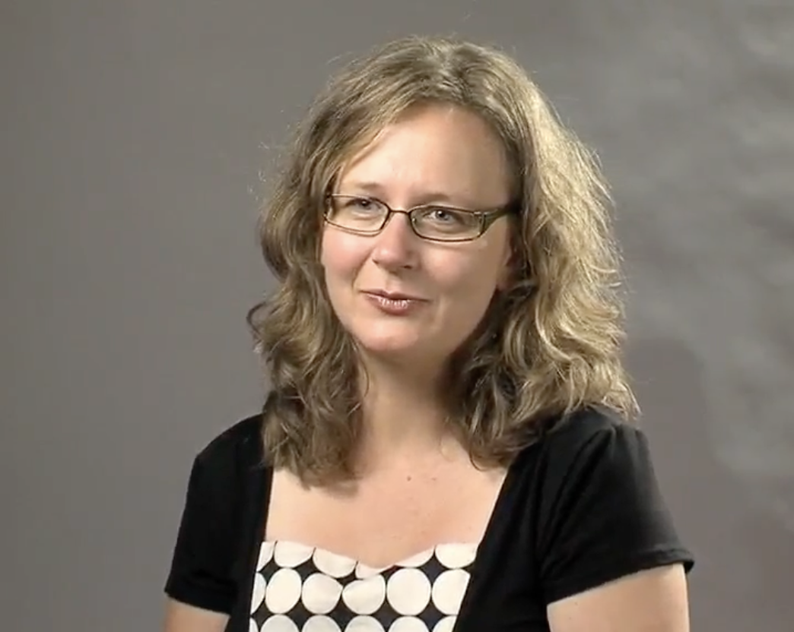
Advice from the experienced IMGs
Watch the advice video
Advice that the doctors provided
  • Find out about the training system and exams
  • Find out how the hospital system works
  • Have an open mind and be willing to learn
  • Become part of the community, not just in the hospital
  • Be willing to give from your own experience
  • Don’t give up

Slide 10
Advice from the experienced IMGs
For discussion:
  • What advice did you get before you came
  to Australia?
  • Was the advice you got correct, and was
  it useful?
  • What other advice would be have been useful
  to you?
  • What advice would you give to a friend thinking
  of working in Australia?
  • Would you give different advice to someone who was thinking of emigrating to Australia?

Slide 11


